Slide 1
Binary Search Tree
Binary Search Tree is a binary tree in which every node contains only smaller values in its left subtree and only larger values in its right subtree.
In a binary tree, every node can have maximum of two children.
The following operations are performed on a binary search tree...
Search
Insertion
Deletion

Slide 2
Construct BST:-
10,12,5,4,20,8,7,15 and 13

Slide 5
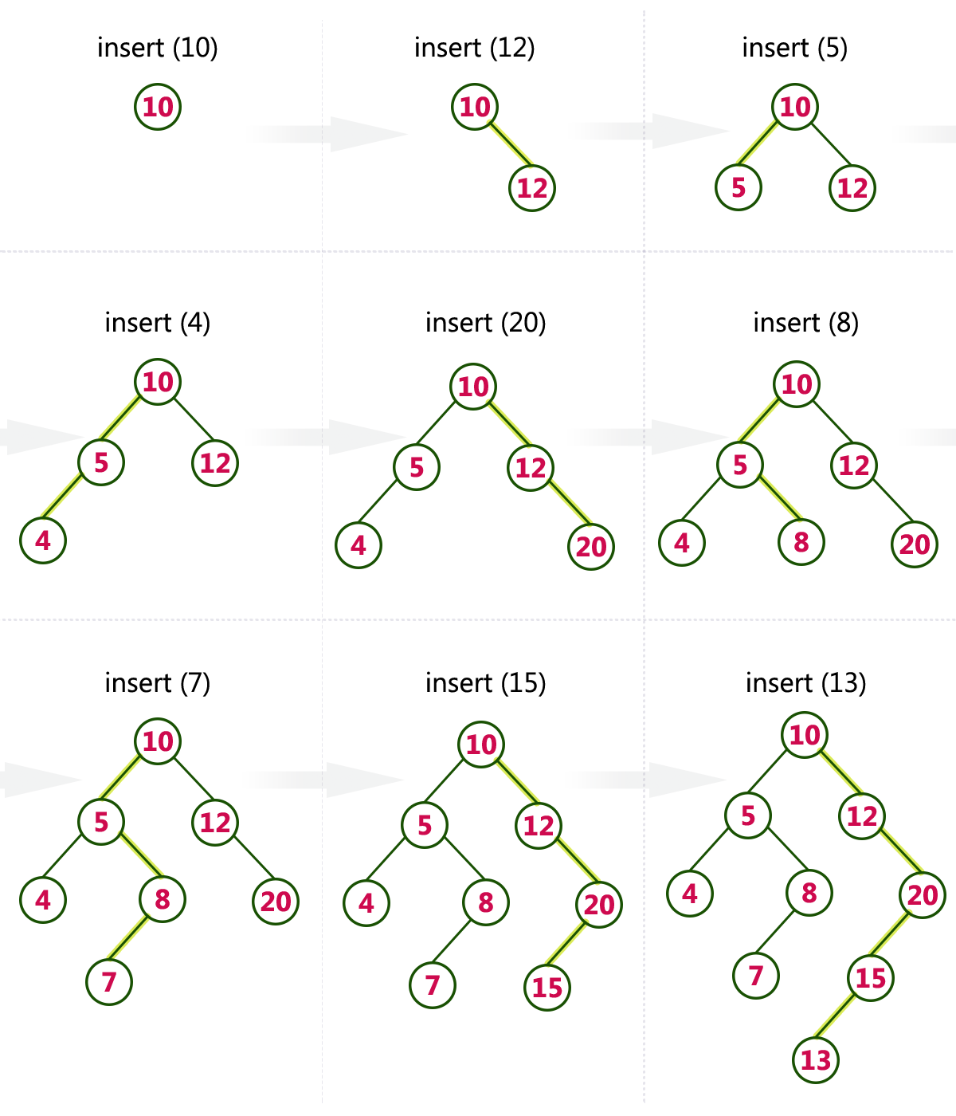

Slide 6
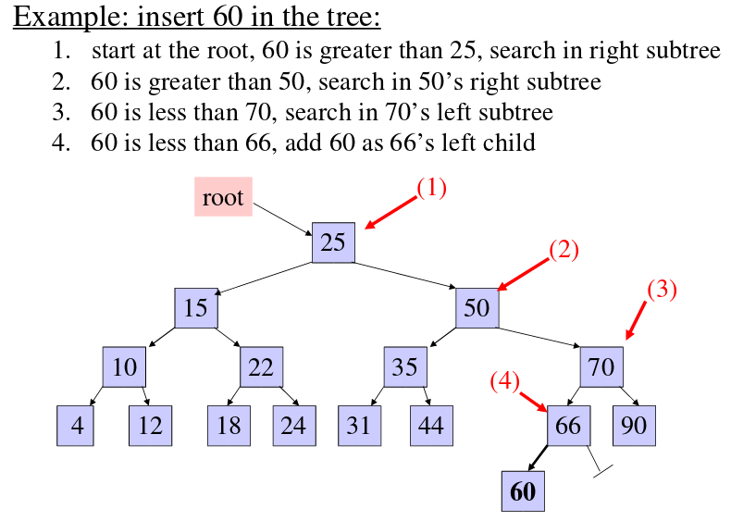

Slide 7
Algorithm for insert operations:
Step 1: Create a newNode with given value and set its left and right to NULL.
Step 2: Check whether tree is Empty.
Step 3: If the tree is Empty, then set set root to newNode.
Step 4: If the tree is Not Empty, then check whether value of newNode is smaller or larger than the node (here it is root node).
Step 5: If newNode is smaller than or equal to the node, then move to its left child. If newNode is larger than the node, then move to its right child.
Step 6: Repeat the above step until we reach to a leaf node (e.i., reach to NULL).
Step 7: After reaching a leaf node, then isert the newNode as left child if newNode is smaller or equal to that leaf else insert it as right child.

Slide 8
Coding for insert:
struct Node
{
int data;
struct node *left, *right;
};
Struct Node *root=NULL;

Slide 9
struct Node* insert(struct Node *root,int value)
{
struct Node *newNode;
newNode = new Node;
newNode->data = value;
If(root==NULL)
{
newNode->left = newNode->right = NULL;
root = newNode;
}
else
{
if (data < root->data)
root->left = insert(root->left, data);
else if (data > root->data)
root->right = insert(root->right, data);
}
return root;
}

Slide 10
Algorithm for Search operations:
Step 1: Read the search element from the user
Step 2: Compare, the search element with the value of root node in the tree.
Step 3: If both are matching, then display "Given node found!!!" and terminate the function
Step 4: If both are not matching, then check whether search element is smaller or larger than that node value.
Step 5: If search element is smaller, then continue the search process in left subtree.
Step 6: If search element is larger, then continue the search process in right subtree.
Step 7: Repeat the same until we found exact element or we completed with a leaf node
Step 8: If we reach to the node with search value, then display "Element is found" and terminate the function.
Step 9: If we reach to a leaf node and it is also not matching, then display "Element not found" and terminate the function.

Slide 11
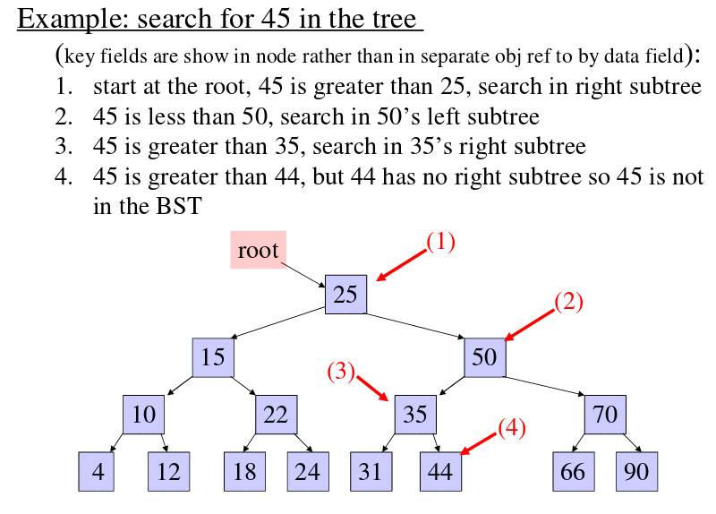
Search operation:

Slide 12
Coding for search:
struct node* search(struct node* root, int key)
{
// if root is null or key is present at root
if (root == NULL || root->data== key)
return root;
// Key is greater than root's data
if (root->data < key)
return search(root->right, key);
// Key is smaller than root's data
return search(root->left, key);
}

Slide 13
Binary Tree Traversals
When we wanted to display a binary tree, we need to follow some order in which all the nodes of that binary tree must be displayed. In any binary tree displaying order of nodes depends on the traversal method.
There are three types of binary tree traversals.
In - Order Traversal
Pre - Order Traversal
Post - Order Traversal

Slide 14
In - Order Traversal ( leftChild - root - rightChild )
Pre - Order Traversal ( root - leftChild - rightChild )
Post - Order Traversal ( leftChild - rightChild - root )

Slide 15
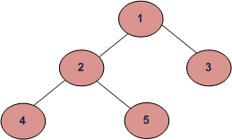
In - Order Traversal ( leftChild - root - rightChild )
Example1:
In Order: 4 2 5 1 3
Pre Order: 1 2 4 5 3
Post Order: 4 5 2 3 1

Slide 16
Algorithm(In order Traversal )
Until all nodes are traversed −
Step 1 − Recursively traverse left subtree.
Step 2 − Visit root node.
Step 3 − Recursively traverse right subtree.

Slide 17
Algorithm(Pre Order Traversal)
Until all nodes are traversed −
Step 1 − Visit root node.
Step 2 − Recursively traverse left subtree.
Step 3 − Recursively traverse right subtree.

Slide 18
Algorithm(Post Order Traversal)
Until all nodes are traversed −
Step 1 − Recursively traverse left subtree.
Step 2 − Recursively traverse right subtree.
Step 3 − Visit root node.

Slide 19
Algorithm for delete operations:
Deleting a node from Binary search tree has following three cases...
Case 1: Deleting a Leaf node (A node with no children)
Case 2: Deleting a node with one child
Case 3: Deleting a node with two children
Case 1: Deleting a leaf node
We use the following steps to delete a leaf node from BST...
Step 1: Find the node to be deleted using search operation
Step 2: Delete the node using free function (If it is a leaf) and terminate the function.

Slide 20
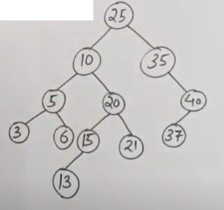
Ex:BSTdelete:
Delete
Leaf
Non-Leaf

Slide 21
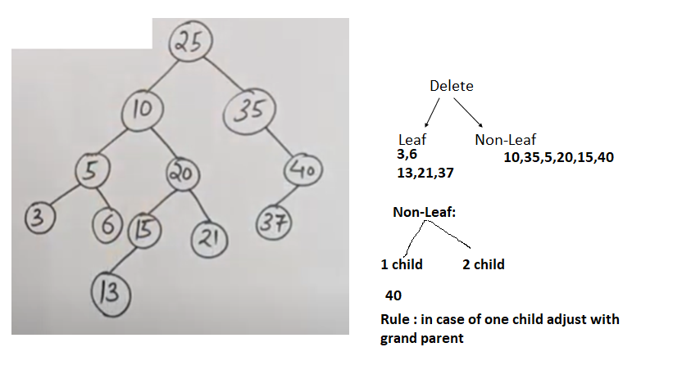

Slide 22
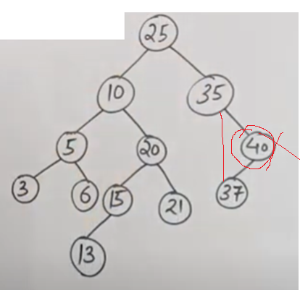
40 deleted

Slide 23
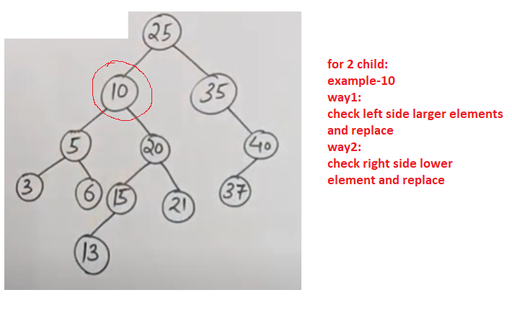

Slide 24
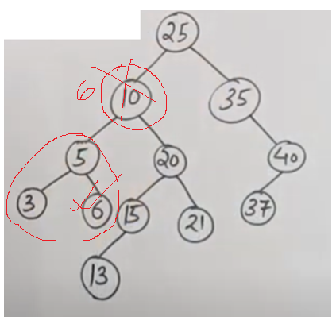
Way 1

Slide 25
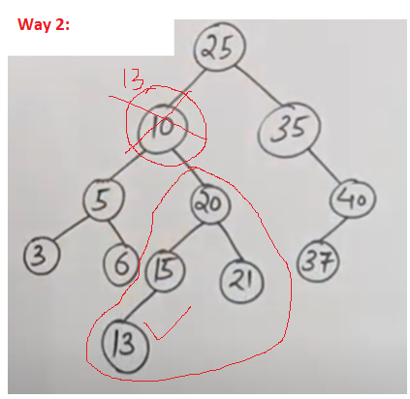

Slide 26
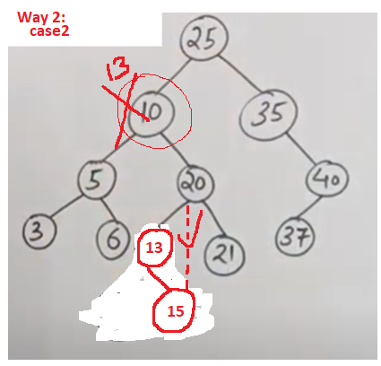

Slide 27
Case 2: Deleting a node with one child
We use the following steps to delete a node with one child from BST...
Step 1: Find the node to be deleted using search operation
Step 2: If it has only one child, then create a link between its parent and child nodes.
Step 3: Delete the node using free function and terminate the function.

Slide 28
We use the following steps to delete a node with two children from BST...
Step 1: Find the node to be deleted using search operation
Step 2: If it has two children, then find the largest node in its left sub tree (OR) the smallest node in its right sub tree.
Step 3: Swap both deleting node and node which found in above step.
Step 4: Then, check whether deleting node came to case 1 or case 2 else goto steps 2
Step 5: If it comes to case 1, then delete using case 1 logic.
Step 6: If it comes to case 2, then delete using case 2 logic.
Step 7: Repeat the same process until node is deleted from the tree.

Slide 29
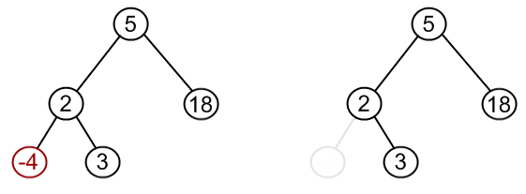
Node to be removed has no children.
Ex:-4 from BST

Slide 30
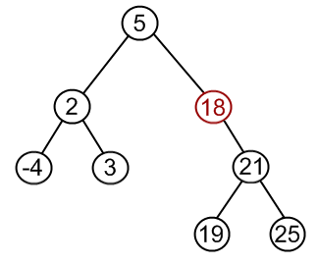
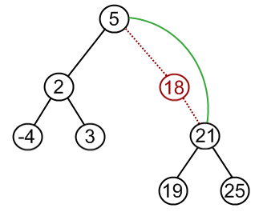
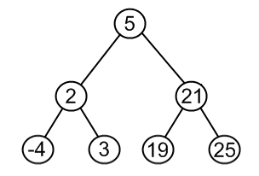
Node to be removed has one child.
Example. Remove 18 from a BST. Copy the child to the node and delete the child

Slide 31
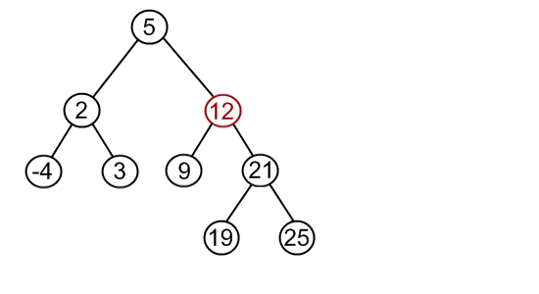
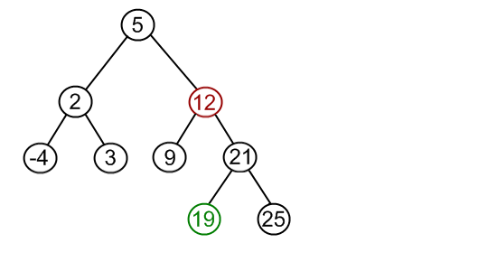
Node to be removed has two children.
Example. Remove 12 from a BST.
Find minimum element in the right subtree of the node to be removed. In current example it is 19
Replace 12 with 19. Notice, that only values are replaced, not nodes. Now we have two nodes with the same value.

Slide 32
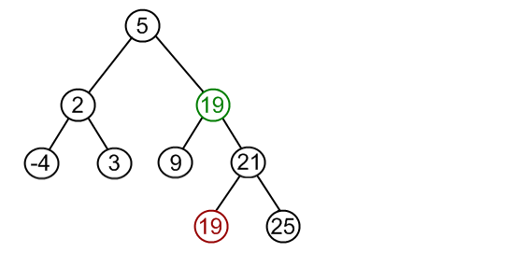
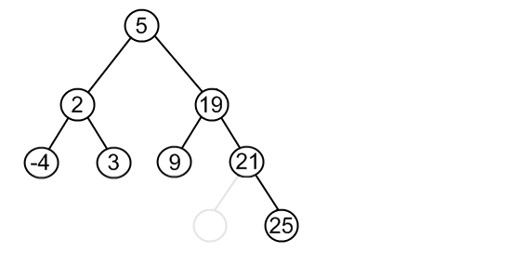
Remove 19 from the left subtree.

